Slide 1
Java Capstone Project
Team 7
Team members names :
1- Ismail Elsayed (7218930) 2- Mohamed Rizwan (7218982)
3- Amr Abdelaziz (7216843) 4- Bekzod Nazarov (7219292)

Slide 2





System Architecture
Station
Car Queue
Whether
Charging Station
Energy Management

Slide 3
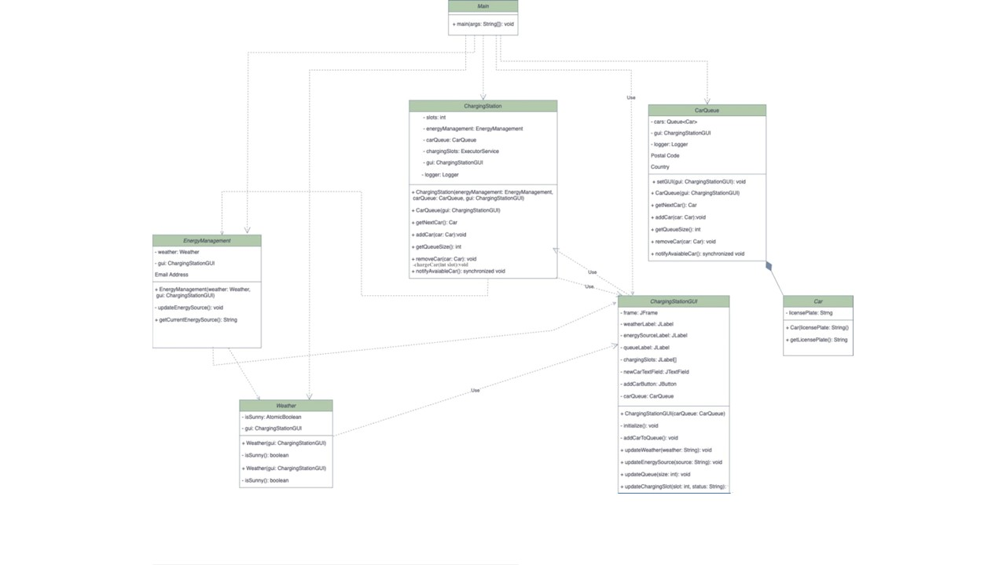
Class Diagram for the capstone project

Slide 4
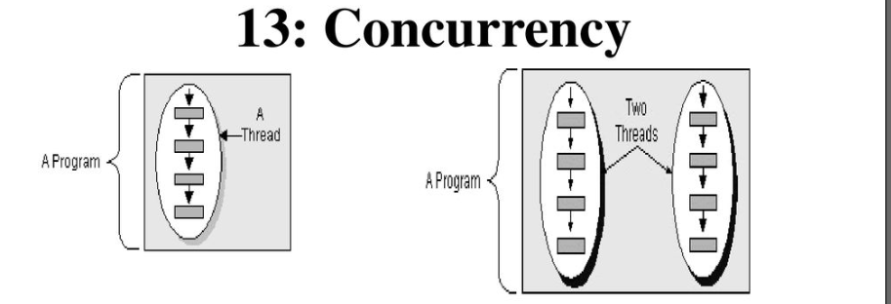
Concurrency & Threading

Slide 5
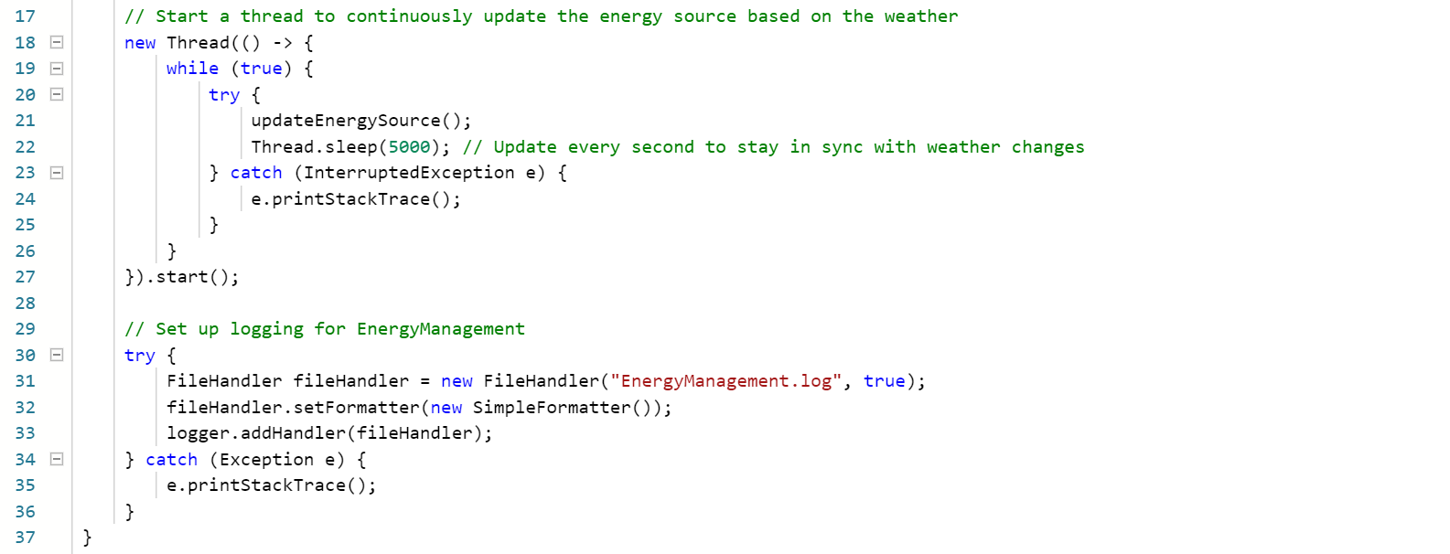
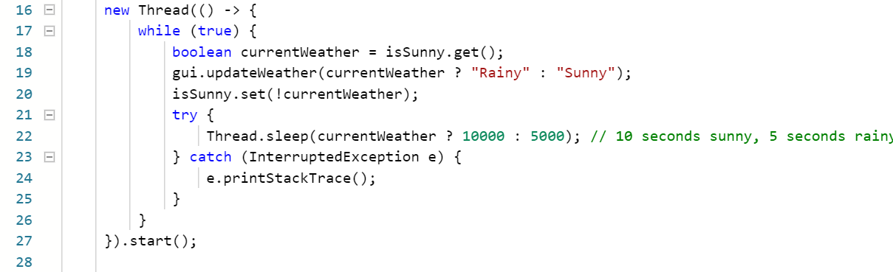
Threading

Slide 6
Handling exception& GUI
Handling exception problems:
1-File Handling Errors:File handling operations, such as creating log files or reading configuration files, can fail due to various reasons, such as insufficient permissions or file not found errors.
2-Logging Errors:Errors or exceptions occurring during logging operations, such as initializing loggers or writing log messages to files, can go unnoticed if not properly handled.
3- Thread Interruption:Threads performing long-running tasks, such as charging cars, may be interrupted abruptly due to external factors, such as application shutdown or user cancellation.
GUI problems:
1-Swing Threading : Issues:Swing is not thread-safe, and all GUI-related operations should be performed on the Event Dispatch Thread (EDT) to avoid concurrency issues and ensure responsiveness
2-Event Handling:Event handling for GUI components, such as button clicks or text field input, is implemented inline within the initialize() method using lambda expressions. While this approach is concise, it can make the code less readable and harder to debug, especially for complex event handling logic.

Slide 7
Handling exception& GUI
Handling exception solution:
1-File Handling Errors:Wrap file handling operations in try-catch blocks to handle potential IOExceptions or other file-related exceptions gracefully. Provide meaningful error messages or log the exceptions for debugging purposes. Ensure that resources, such as file handlers, are properly closed in a finally block or using try-with-resources construct to prevent resource leaks.
2-Logging Errors:Implement robust error handling for logging operations by wrapping log-related code in try-catch blocks. Log any exceptions or errors encountered during logging to a separate error log file or console for debugging purposes. Ensure that logging operations do not interfere with the normal execution of the application.
3- Thread Interruption:Handle InterruptedException properly in long-running threads to ensure graceful thread termination. For example, in the chargeCar() method of the ChargingStation class, catch InterruptedException and gracefully exit the thread by restoring the interrupted status if necessary.
GUI solution:
1-Swing Threading Issues:Use SwingUtilities.invokeLater() or SwingUtilities.invokeAndWait() to execute GUI updates on the EDT. For example, in methods like updateWeather(), updateEnergySource(), updateQueue(), and updateChargingSlot(), ensure that Swing components are updated within SwingUtilities.invokeLater() to avoid potential threading issues.
2-Event Handling:Separate event handling logic into dedicated methods or classes to improve readability and maintainability. For example, create separate methods to handle button clicks (addCarButtonClicked()), text field input (newCarTextFieldChanged()), etc. This promotes separation of concerns and makes it easier to understand and modify the code.

Slide 8
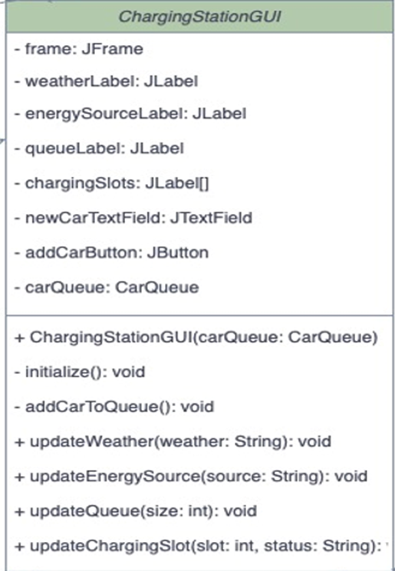
Handling exception & GUI
Diagram for GUI:

Slide 9
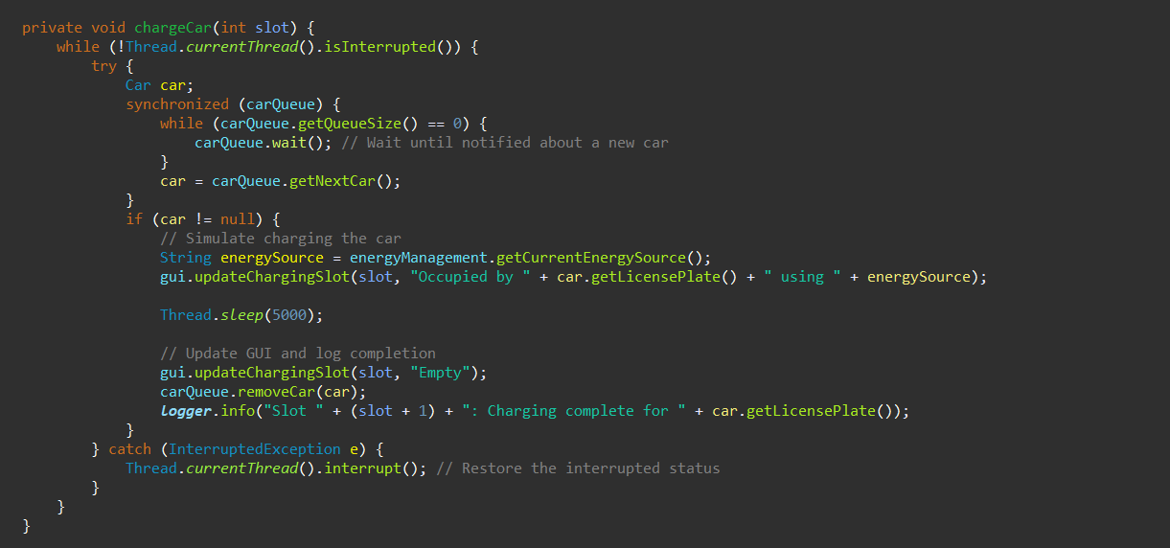
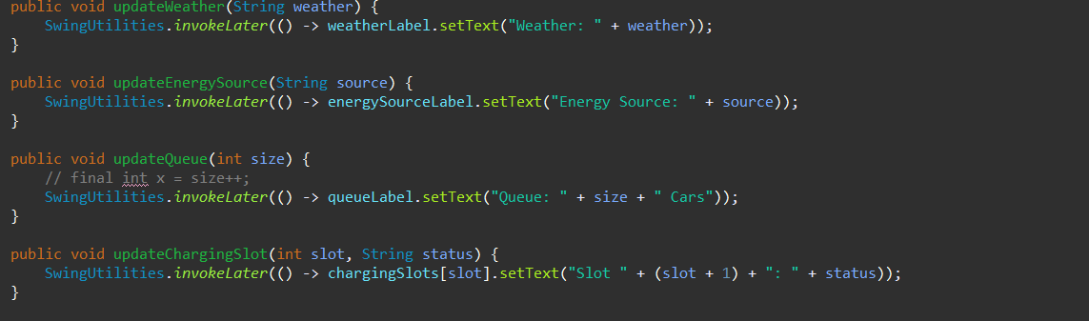
Handling exception & GUI
1- Exception handling code :
2- GUI code :

Slide 10
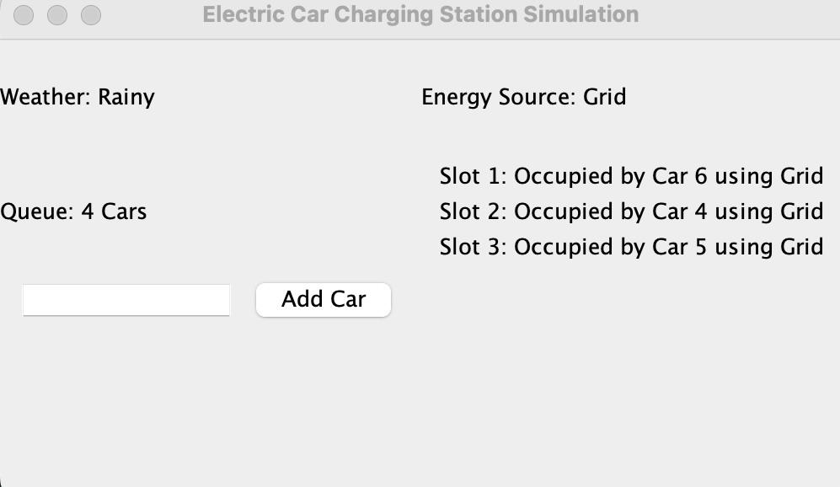
Handling exception& GUI
GUI output :

Slide 11
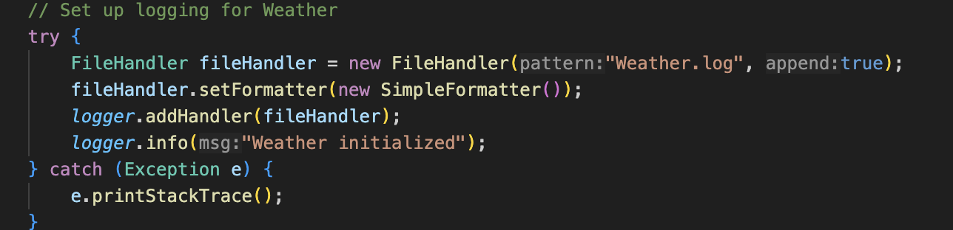
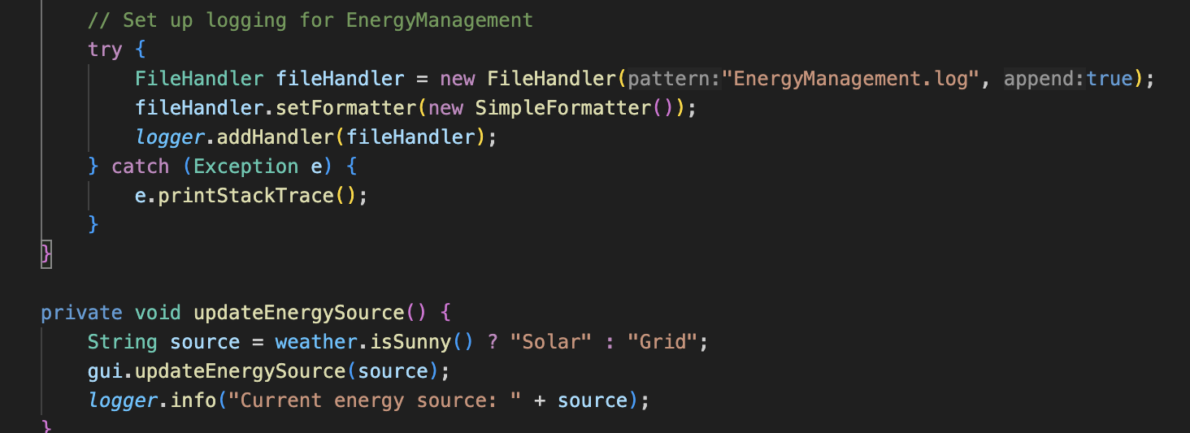
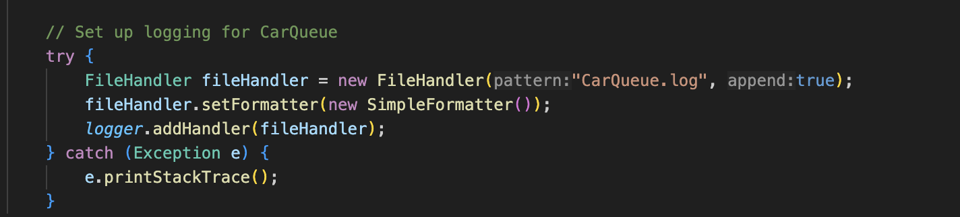
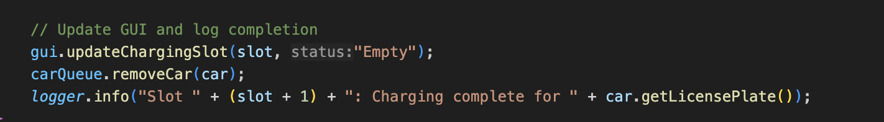
Log Files & File Handler
Each Component
CarQueue
Charging Station
Energy Management
Weather

Slide 12
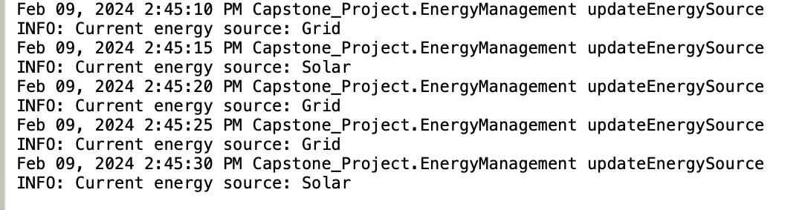
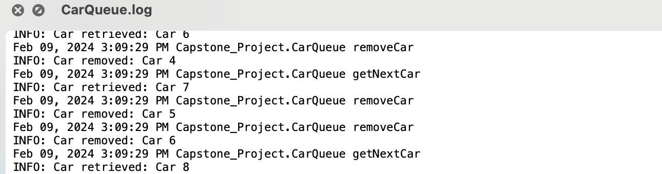
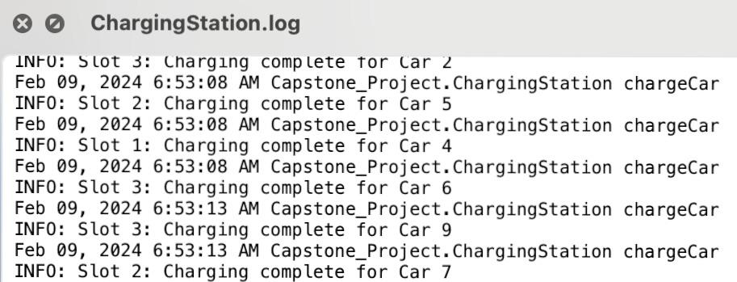
Log Files Output :-

Slide 13
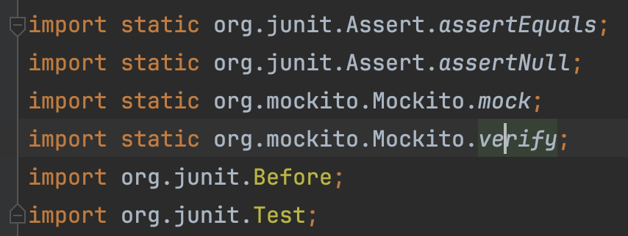
Unit Tests
Libraries used

Slide 14
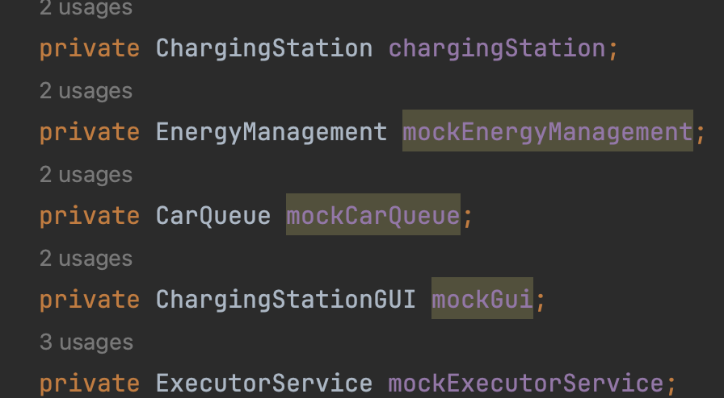
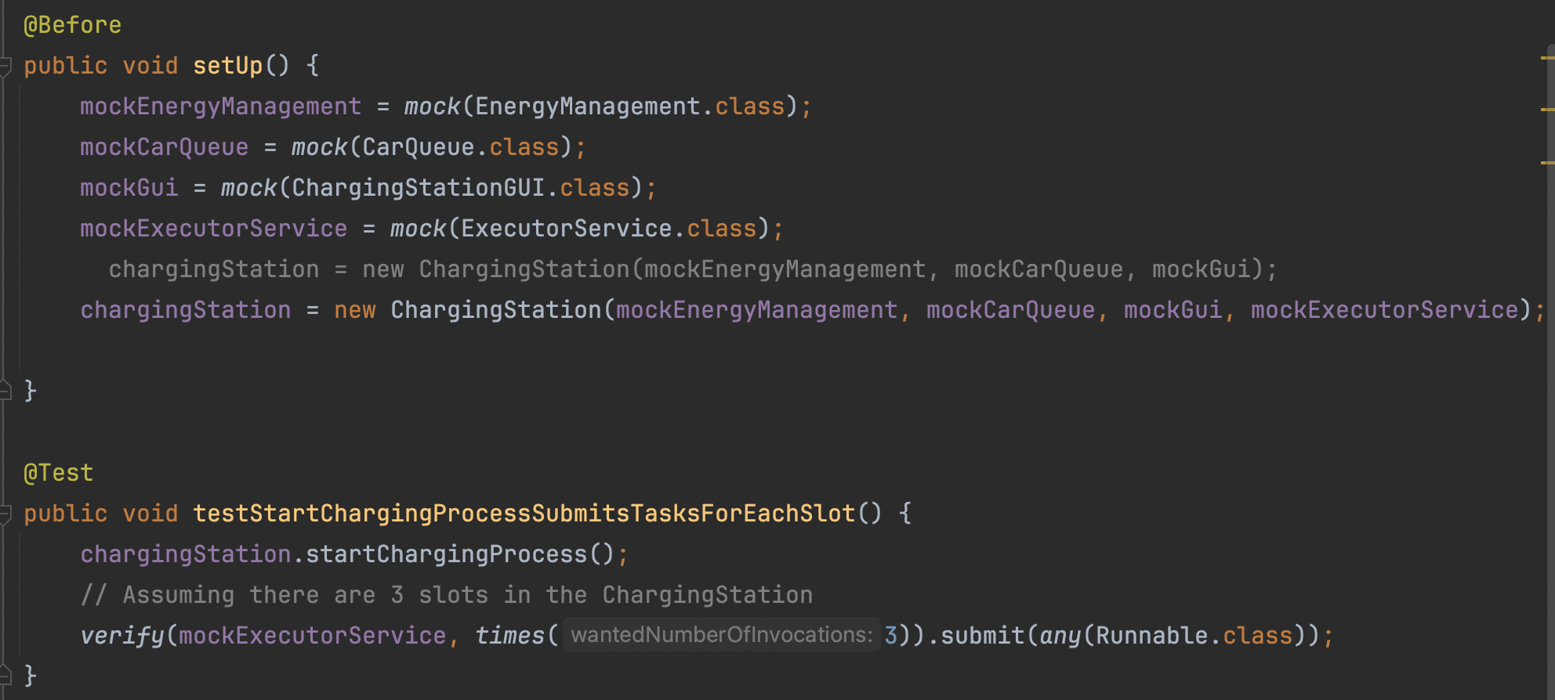
Unit Tests
ChargingStationTest Implementation

Slide 15

Simulation:- (Video)

Slide 16
Thank U

